Slide 1




























W3 Engagement Level Workshop
1 | 2 | 3 | 4 | 5 | 6 | 7
Curious | Active attendee | Active and regular attendee | Contributor | Leader | Leader & Creator | Community Booster
Make current members’ engagement explicit to adjust expectations and better target activities

Slide 2
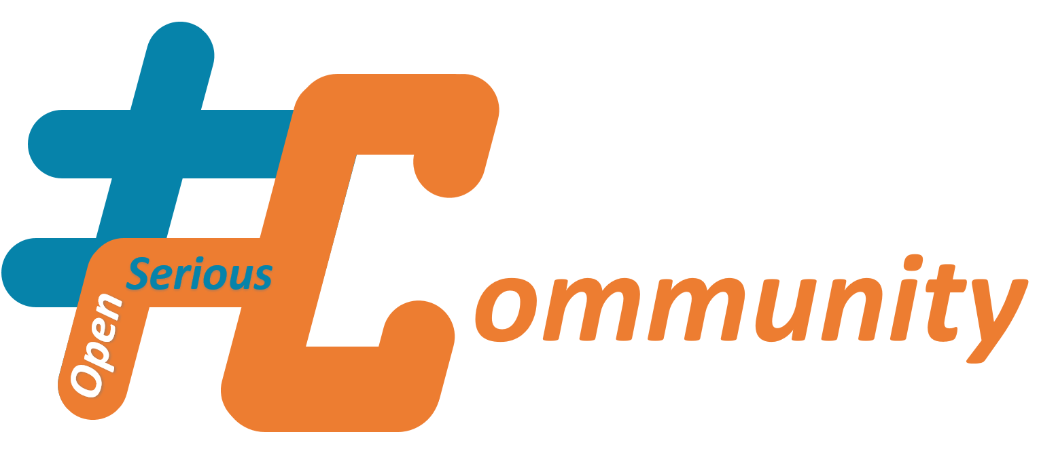
This document is an #OpenSeriousCommunity #OSC content
#OpenSeriousCommunity is a set of resources, organized as a framework, dedicated to help animate, sustain and develop communities.
The communities concerned by #OpenSeriousCommunity can be as much in the corporate domain, as in associations, institutions or private.
The #OpenSeriousCommunity contents follow the attributes of the #OSG contents, meaning that they are open-source, and structured to favor a maximum of appropriation of the content for retransmission purposes.
To learn more, visit https://www.openseriousgames.org/OpenSeriousCommunity

Slide 3
Engagement Level workshop Expected result example
E1 | E2 | E3 | E4 | E5 | E6 | E7
Curious | Active attendee | Active and regular attendee | Contributor | Leader | Leader & Creator | Community Booster
https://en.wikipedia.org/wiki/Flow_(psychology)

Slide 4
Engagement Level workshop Using the result
E1 | E2 | E3 | E4 | E5 | E6 | E7
Curious | Active attendee | Active and regular attendee | Contributor | Leader | Leader & Creator | Community Booster
Propose Subscription to Social network accounts of the Community and react to posts | Invite to events Invite to ask questions in the Community Chat room | Invite to series of events Ask for some basic feedback to improve the Community (using polls) | Offer to register as contributor for microtasks in Community projects or activities Invite to Answers questions in the Community chatroom / forum | Invite to Community decision meetings Invite Organize events Assign projects to lead Invite to collect external content and push in the Community Chatroom | Invite Create original content or push content for the Community Propose creative spaces to express and share their content | Invite to community organization activities Invite to matchmake members
Suggested actions
➔
What to do with the results ?
✔️ Use it to recommend activities that fit the declared level of involvement
💬 Use it to set up subgroups and decide on tools
🔲 Use it to define Community engagement objectives (with stakeholders)
📅 Update it regularly (example : once every quarter or every 10 sessions) or when Community members have drastically changed.

Slide 5
Hosting engagement level workshop

Slide 6
Engagement Level Workshop Workshop step by step
1 | 2 | 3 | 4 | 5 | 6 | 7
Curious | Active attendee | Active and regular attendee | Contributor | Leader | Leader & Creator | Community Booster
 | 1 Introduction | 2 Example result | 3 Rules & Mindset | 4 Fill | 5 Discussion | 6 Decide main activities
Suggested timebox | 5 minutes | 5 minutes | 2 minutes | 10 minutes | 20 minutes | 15 minutes
Action | Explain what motivates the workshop : Avoid frustration or over solicitation of members (Optional) Explain the theory behind the workshop Adjust the activities to how members invest time in the Community | Show expected results of the workshop (previous slide) Show how it will be used (next slide) | Remind the rules & mindset : The sincerest, the easiest it will be on the long term Neither shaming nor congratulating on current engagement level (Optional) If target engagement level is different from current, explain why Reminder : Engagement level are not tastes, each level comes with commitment and responsibilities | Present empty canvas, ask members to add their pictures in the right case. Pictures can be replaced by names (less vivid) Variant: You can also add individual target engagement level | Questions / Answers | From the result, decide what will be the main starting activities in the Community. (Optional) Collectively commit to a Given activity for next session or time period.
Only after a certain date, event

Slide 7
Answering bias : What is shared during the workshop might not be the true engagement level
Results of the Engagement Level Workshop may be biased because of various reasons.
A bias result may be less usable and lead you to make the wrong choices.
Therefore, it is important to reduce the chance of bias, and increase the chance of matching activities
Here are some potential causes for bias and practical solutions for prevention.
Psychological unsafety : Participants might fear revealing that their current level engagement is lower than what they think is the expectation, and therefore “answer up”.
Virtue signaling : Participants might intend to communicate a good character during a collective workshop
Misunderstanding workshop application : Participants might answer without understanding the activities adaptation it implies, therefore not be careful about their answer, answering down or answering up their real level.
Influence by others : Participants might be influenced by other participants to answer something different than they would if they were alone.
Self-image different from reality : Participants might see themselves as less or more engaged than in what practical conditions reveal.
Practical Solutions include various possibilities to adapt to your own context. The solutions are essentially based on :
Removing influence from others : Get anonymous responses, or independent responses (without members seeing what others answered).
Create psychological safety : Explicitly allow participants to answer low engagement. Explain that there will neither be sanctions, compliments, nor reputation effects for declaring any level of engagement. Open declaration to regular update.
Understanding of Workshop use : Explain the interest and importance of getting a true information instead of a fantasized community.

Slide 8
Engagement Level Workshop Preparing to Host Workshop
1 | 2 | 3 | 4 | 5 | 6 | 7
Curious | Active attendee | Active and regular attendee | Contributor | Leader | Leader & Creator | Community Booster
Right conditions ? | (Optional) Level System | Workshop materials | Invitations | (Optional) Additional tips
Check if you are in the right conditions to use this workshop You are currently in need to choose or adjust the next Community activities Your members would feel psychologically safe enough to express themselves during the workshop You have the right conditions (logistics, timing, interest) for participants to attend and spend time on their engagement level | Choose a level system that fit your Community and circumstances Basic level system Levels by type of contribution to Community deliverable Relative Engagement Level Levels by amount and regularity of committed time Level by assumptions of participation | Prepare a board (physical or virtual) with the levels Prepare the portraits (Optional, and more engaging) or at least the nametags Choose whether you want to ask for the current level only or also ask for the engagement level goal Prepare the presentation of the workshop (motivations, psychological safety conditions, …) | Send invitations to your participants with the right pitch (Optional) Propose asynchronous offline answering for members who cannot attend | Brainstorm various ideas of activities depending on the level, so that you can propose more concrete use of the workshop results Prepare different examples of Community formats (Communities with high proportion of low-level engagement, small communities with high engagement only…) that match different types of answer
Only after a certain date, event

Slide 9
Version history
Version | Contributors | Update
1.0 | Alexandre QUACH | First base workshop version
1.1 | Alexandre QUACH | Adding variant : with individual engagement goals
1.2 | Alexandre QUACH | Addition of additional level systems Addition of the #OpenSeriousCommunity Tag & Information Addition of version history Clarification of working assumption
1.3 | Alexandre QUACH | Added names in the additional level systems Addition of “Relative engagement level”
1.4 | Alexandre QUACH | Improved Additional engagement level systems, updated “Levels by type of commitment” to “levels by assumptions of commitment” Added section “Hosting Engagement Level Workshop”
2.0 | Alexandre QUACH | Large improvement and explanation of “Relative Engagement Level” (split in 3 parts : definition, using relative engagement level as a workshop, Increasing Community activity level using relative engagement level”)

Slide 10
Work Assumptions

Slide 11
Engagement Level workshop Working assumptions
Stimulation
Common mistake : Asking for too much
Community Members ➔ Feeling spammed
Community Booster ➔ Frustration
Flow Zone : Best for stimulation
Common mistake : Asking for too few
Community Members ➔ Boredom
Community Booster ➔ Missing opportunities
Sense of Belonging
E1 | E2 | E3 | E4 | E5 | E6 | E7
“You got my attention” | “I want to experience something” | “I want reasons to come again” | “I want to feel involved” | “I want to lead something” | “I want to add my own touch” | “I want to gather people around this topic”
https://en.wikipedia.org/wiki/Flow_(psychology)

Slide 12
Engagement Level workshop Working assumptions
Stimulation
Common mistake : Asking for too much
Community Members ➔ Feeling spammed
Community Booster ➔ Frustration
Flow Zone : Best for stimulation
Common mistake : Asking for too few
Community Members ➔ Boredom
Community Booster ➔ Missing opportunities
Sense of Belonging
The workshop assumes that
every member (or potential member) has, at a time t, a “engagement level” towards a Community
This engagement level can vary over time
Requesting more engagement from a member than his/her current engagement level, can decrease the engagement level (member is feeling spammed)
Requesting less engagement from a member than his/her current engagement level, can decrease the engagement level (member is feeling boredom)
Feeling respected in one’s current engagement level can increase engagement level over time

Slide 13
Basic Level system

Slide 14
Engagement Level workshop What the basic level system means
 | E1 | E2 | E3 | E4 | E5 | E6 | E7
 | Curious | Active attendee | Active and regular attendee | Contributor | Leader | Leader & Creator | Community Booster
What members are ready to give to the community | ATTENTION | ATTENTION + ENOUGH TIME TO EXPERIMENT | ATTENTION + ENOUGH TIME TO EXPERIMENT + RECURRING ATTENDANCE | ATTENTION + ENOUGH TIME TO EXPERIMENT + RECURRING ATTENDANCE + WILLINGNESS TO CONTRIBUTE | ATTENTION + ENOUGH TIME TO EXPERIMENT + RECURRING ATTENDANCE + WILLINGNESS TO CONTRIBUTE +WILLINGNESS TO TAKE RESPONSIBILITIES | ATTENTION + ENOUGH TIME TO EXPERIMENT + RECURRING ATTENDANCE + WILLING NESS TO CONTRIBUTE +WILLINGNESS TO TAKE RESPONSIBILITIES +WILLINGNESS TO BUILD | ATTENTION + ENOUGH TIME TO EXPERIMENT + RECURRING ATTENDANCE + WILLINGNESS TO CONTRIBUTE +WILLINGNESS TO TAKE RESPONSIBILITIES +WILLINGNESS TO BUILD +WILLINGNESS TO RALLY
What members can possibly expect from the Community | Interesting content | Pleasant experience | - Interest and Utility - Usefulness of community or content experience | - Feeling of being active - Concrete effects resulting from one’s action - Sense of belonging in something bigger Better self-image Alignment of values | Responsibilities Risk of loss and more meaningful success Challenge and opportunity to succeed | - A space to express oneself - Support and tools for creativity - Feeling of being aligned with oneself Posterity Significance | Unattended crowds to conquer Significance Large Vision

Slide 15
Engagement Level workshop Example activities for basic level system
E1 | E2 | E3 | E4 | E5 | E6 | E7
Curious | Attendee | Active and regular attendee | Contributor | Leader | Leader & Creator | Community Booster
Subscribe to a content thread (social media account, etc.) Agree to receive content (newsletters, brochure, etc.) Join a messaging room (or get invited to it) | Watch or listen to an online content. Attend to an event in which you can act passively : Inspirational speaker, presentation, etc. | Introduce yourself to other members Answer to a quiz, a poll or a study React to a content (with likes, etc) Follow an online course with online exams Ask questions after or participate to discussions among peers after an event | Actively review & comment content (article, video, …), write down a feedback Post external content in the Community messaging room Co-author a common deliverable | Host a collective intelligence workshop Participate to an active pedagogy training Prepare an event outside of the Community Manage a Community task from A to Z Take an official Community role | Organize a working group (set up a team, define goals, organize planning, produce, share, etc.) Design an event and host it Create original content by yourself Design the community roadmap | Organize the Community Manage conflicts within and with the Community Structure Community processes Do whatever is not covered by roles of previous levels

Slide 16
Variant with individual engagement goals

Slide 17

Engagement Level workshop variant : Adding GOALS for next time period
E1 | E2 | E3 | E4 | E5 | E6 | E7
Curious | Active attendee | Active and regular attendee | Contributor | Leader | Leader & Creator | Community Booster

Slide 18
Engagement Level workshop variant : using nametags instead of portraits
Current level
Goal (if different from current level)
E1 | E2 | E3 | E4 | E5 | E6 | E7
Curious | Active attendee | Active and regular attendee | Contributor | Leader | Leader & Creator | Community Booster
Giacomo
Umberto
Laura
Andrea
Luciano
Ilaria
Fabio
Paolo
Toto
Gianni
Albano
Laura
Natalia
Adriano
Romina
Toto
Romina
Umberto

Slide 19
Additional engagement level systems

Slide 20
Changing the level system to other dimensions Examples
Levels by assumptions of participation
E1 | E2 | E3 | E4 | E5 | E6 | E7
I will not participate by default | By default, I will not participate but exceptions are unknown yet | By default, I will not participate, and exceptions are known in advance and limited | By default, I will participate, but exceptions are unknown yet | By default, I will participate, and exceptions are known in advance and cannot change | By default, I will participate, exceptions are known in advance and still can change | By default, I will participate with exception of well-defined cases of force majeure
There are multiple ways to define engagement levels.
The definition of Engagement levels can be adjusted to facilitate decision making about community activities, within the condition that the levels are easily understandable by workshop participants.
As inspiration, here are other examples to use. You can also choose to set less levels or more levels to make the scale simpler or more details
Levels by amount and regularity of committed time
E1 | E2 | E3 | E4 | E5 | E6 | E7
<15 minutes occasionally | 15min-1h occasionally | 1h-3h occasionally | More than 3h occasionally | 15 min-1h regularly (>15 min a week) | 1h-3h Regularly (> 1h a week) | More than 3h regularly (>3h a week)
Levels by type of contribution to a Community deliverable
E1 | E2 | E3 | E4 | E5 | E6 | E7
Snacker | Follower | Finder | Editor | Author | Organizer | Booster
Get informed globally (summaries, etc.) from afar without contributing | Get informed in detail without contributing | Provide information for deliverable (but no direct contribution) | Contribute to deliverable details | Contribute to deliverable details and content organization | Contribute to details, content organization, and organization of delivery | Organizer who also covers whatever work remains from previous levels

Slide 21






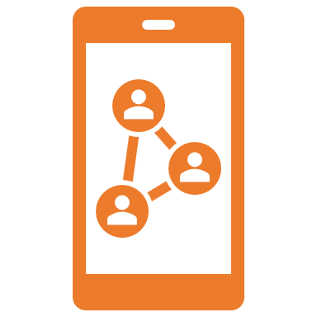
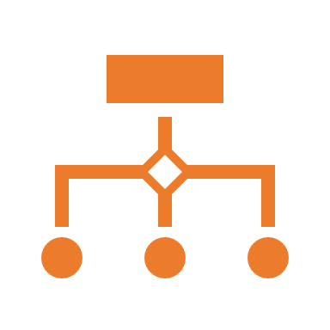

Choosing an engagement level system Example choices
Depending on your situation, choosing the right level system can help you define Community tactics and activities after your engagement level measurement.
For example, if you do not have much choice in the activity other than its duration, you may choose Levels by amount and regularity of committed time
If you have various medias and collective moments to use with your Community, and would like to target people better, you can use Basic Level System.
If your Community is built around delivery of collectively produced content (for example, a collective book, a collective wiki, a website, etc.), you can use Levels by type of contribution to a Community deliverable.
If you have several potential topics in your Community you can choose for your activities, you can use “Relative Engagement Levels” (see dedicated section).
If you need to plan attendance with reliable information on participation, you can use Levels by assumptions of participation
Smaller, simpler Communities can use less levels, while more sophisticated communities can benefit from having from engagement levels.
We recommend not to choose an engagement level system by habit only or by copying some other Community. You can choose an engagement level system that fits your Community and the next choices you must make.
You can even use different level systems for a same Community, but each for different circumstances.

Slide 22
Relative Engagement Levels

Slide 23
Another definition of engagement and relative Engagement levels
In the previous level systems above, engagement was defined mostly by its signs (taking more and more responsibilities, being available more hours, etc.). This led to level systems that were simple to use when it comes to define which activities are proposed to which members.
Yet this way of measuring engagement does not consider the idea that a same given member can engage differently on different community topics and matters. For example, giving several hours and take responsibilities on a topic A, and just being a curious person about the topic B.
If we define engagement as the ability to provide effort towards a delayed goal, beyond direct instant interest, then we obtain another scale, which is more relative to every member’s engagement and not to activity level only.
Using this definition of engagement, we separate the two concepts of “being active” and of “being engaged”. The high level of activity of a member could be related to a strong short-term interest, while this member may leave when it comes to activities with indirect delayed interest. Measuring “engagement” through its external usual signs (number of hours, amount of shared content, etc.) becomes no longer relevant or enough.
This new definition of engagement level can better explain phenomena of “engagement drops”, “sudden disinterest”, and “lack of involvement of highly active members when it comes to Community matters”.
It also explains why improving the direct value of community activities (more interesting, more fun, etc.) does not always lead to involvement in making the Community better in the long term, or why long-term activities (capitalization, organization, etc) are not attractive while the number of members is high.
To make the reader more comfortable in the next section, we will mostly use the term of “Relative Engagement” to discern it from usual “Engagement” term.

Slide 24
Questions that better answered with the Relative Engagement Levels model
How to make the members more active in the Community ?
Why contributors to the Community are always the same ?
Why are the participation levels in some activities so low, even though it is recognized as valuable by members ?

Slide 25
Another definition of engagement and relative Engagement levels model
Quantity of effort a member is ready to provide…
For direct value (instant positive effect)
Direct value here means positive effects that happen for oneself, directly during the Community activities. For example, if a member solves his own operational problem during a community session, it is direct value. We can also call it short-term value.
For indirect value (delayed or long-term positive effect)
Indirect value here means either positive effects that will happen for oneself, later than directly during Community activities, or an increase of the future positive effects that will happen. We can also call-it long term value.
For examples, if a member participates to a workshop that helps the Community select future topics, it is indirect value. If a member works on a topic that is not directly valuable by him but will be useful later-on (for example, in several months), then it is also indirect value. t
For unclear value
(Without any assumption of positive effect on self)
Engagement level
The highest engagement level in this model is when a member provide efforts for the Community, even when there is (at the time of the effort) no clear direct or indirect value for him/her. We can also call this part unclear value.
This model assumes that members can provide more effort for direct value, less for indirect value, and less without any assumption of positive effect on self.

Slide 26




Clarifying what “effort” means in a Community Examples
There could be several types of efforts a member can provide in order to get value from Community activities, including (non exhaustive list) :
Type of effort | Examples of efforts
Efforts of focus, paying attention or keeping one’s concentration | Watching videos, reading text, listening to audio, with attention Trying to attend activities or check content in an unmastered language (e.g.: moments in English for international purpose, but with non-fluent speakers) Trying to follow an advanced presentation in an unmastered topic Receiving content in an attention requiring format (e.g. : long articles or videos) Trying to focus while having notifications and other activities in parallel (e.g. : remote multitasking) Trying to focus while having other unrelated emergencies in mind Trying to focus while having to keep vigilance in parallel (e.g. : listen to a podcast while driving) Visual attention needed to follow fast-movements or fast-paced content Keeping oneself aware of Community news (e.g.: searching for last news, etc.) Maintaining concentration in remote when not used to maintain concentration in remote
Efforts of interaction | Refraining from talking Listening to others with attention to their implicit signals Replying intelligently and with authenticity when one is asked questions Avoiding certain types of reaction (e.g.: strong emotional expressions like tantrum, bursting into tears, …) in presence of others Daring to interrupt others, accepting to be interrupted, trying to find one’s place within a group of unknown people Adjust to communication style, language, level of noise, etc. of someone Learn a new interaction tool or method Finding one’s way in a difficult user interface (low usability, bugs, difficulties to read, slowness, etc.)

Slide 27




Clarifying what “effort” means in a Community Examples
There could be several types of efforts a member can provide in order to get value from Community activities, including (non exhaustive list) :
Type of effort | Description and examples of efforts
Efforts of decision making, commitment | Collecting the necessary information to take a decision (advantages, drawbacks, consequences, etc.) Presenting the possibilities in an understandable manner (e.g.: creating presentation, writing down summaries, etc.) Organizing a collective decision process (vote, committee, etc.) Communicating the decision (e.g. : creating content and organize events to communicate decision) Deciding of topics, time and place, activities format, tools, materials, … Ensuring commitment to a decision (follow-up, etc.) Effort of assessing the capacity to commit (estimate availability, resources, etc.)
Efforts of learning | Learning a community purpose, habits, customs Learning new tools and materials to perform activities Meeting new people, learning names, jobs, etc. Learning processes Learning new topics Applying learning good habits (reflectivity, noting, etc.)

Slide 28

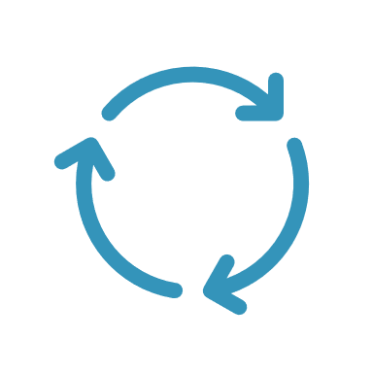




Clarifying what “effort” means in a Community Examples
There could be several types of efforts a member can provide in order to get value from Community activities, including (non exhaustive list) :
Type of effort | Description and examples of efforts
Efforts of context-switching | Working on topics that are very different from the current work topics, and that require deep knowledge of the context to get something Reflecting on several contexts and examples within one same session, or change contexts and examples on every session (without enough time to digest information) Showing several reasoning points without common consistency, or following a common thread Moving from one remote tool to another
Efforts of scheduling, time arrangement, logistics | Changing time, adjusting agenda, cancelling, etc. Comparing incompatible activities happening in the same time and choosing one Keeping oneself aware of Community schedules Moving from one session to another without breaks
Efforts of appreciating | Trying to appreciate a topic to which negative judgements have been associated Trying to appreciate an activity to which negative judgements have been associated Trying to appreciate a person or group of persons to which negative judgements have been associated Adjusting self-image and image to others when changing one’s opinion or level of appreciation

Slide 29


Clarifying what “effort” means in a Community Examples
There could be several types of efforts a member can provide in order to get value from Community activities, including (non exhaustive list) :
Type of effort | Description and examples of efforts
Efforts to maintain psychological safety (of self and others) | Maintaining confidentiality of what is shared Avoiding certain types of reaction (e.g.: strong emotional expressions like tantrum, bursting into tears, …) in presence of others Convincing oneself to dare talk about difficulties Convincing oneself to dare participate to Community activities during worktime Convincing acquaintances (including manager), that time invested in the Community is worth it Daring to take time to learn while others do not approve that learning is an important professional activity
Physical efforts | Staying active and awake during a full day of workshops and other community activities

Slide 30

Clarifying what “effort” means in a Community
There could be several types of efforts a member can provide in order to get value from Community activities, including (non exhaustive list) :
Type of effort | Description and examples of efforts
Effort in “maintaining effort accumulation” (low rest) | Trying to focus on attention-requiring topics while tired of attention-giving activities at the end of the day Trying to maintain concentration in a phase with high density of work Working on a deliverable while already tired from working on other deliverables Making efforts to keep a sound interaction with people while being tired of interactions Trying to keep working on work topics during breaks or on the evening Meeting people from one’s company during official break-time from job Going further in topics from one’s job during official break-time from job

Slide 31










Activities ranking from high to low proportion of direct value Member’s point of view
High proportion of direct value Low proportion of direct value
An activity that is currently about me, my current goals, my current issues, tastes, that I already have in mind
An activity that is currently about me, my current goals, my current issues
that I did not have in mind
An activity with a sure indirect impact on me (for example, that currently impacts someone close to me)
An activity with a potential (unsure) direct impact on me (for example, that impacts members similar to me)
An activity with a potential indirect impact on me (for example, a topic that may impact someone close to me)
An activity with an unclear impact about me (directly, or indirectly, short or long term)

Slide 32
Example of community activities with various proportions of direct value ✍️Content, 📅Events, ⚙️Structure
High proportion of direct value Low proportion of direct value
✍️ Individually targeted content (from target point-of-view)
✍️ Collectively targeted content (ex: content about Community topic)
✍️ Collectively chosen content (is useful for a majority of members)
✍️ Content chosen by a minority of members
✍️ Individually targeted content (from non-target point-of-view)
✍️ Individually chosen content (from non-choser point-of-view)
✍️ Non targeted / Standard content (ex: from the company)
⚙️Polls, interviews, and other inquiries about members
📅✍️Solving current problem of a member (from requester point-of-view)
📅✍️Solving future problem of a member (from requester point-of-view)
📅✍️Solving current collective problem
📅✍️Solving future collective problem
📅✍️Solving current problem of a member (from helpers point-of-view)
📅✍️Solving future problem of a member (from helpers point-of-view)
📅⚙️Community organization & governance definition
⚙️Community administrative paperwork & obligations
📅Custom-made event for one member (from this member point-of-view)
📅Custom-made event for all members, marketplace-like events
📅Custom-made event for a majority of members
📅Custom-made event for a minority of members (from this minority pov)
📅Custom-made event for other members
📅Custom-made event for one member (from other members point-of-view)
📅Standard events not adapted to the Community
⚙️Setting up Community tools
📅Events fully for non community members without value for members
📅Free food, beverage, etc.
📅Community celebration moments
📅Collective production of Community deliverables (for Community)
📅⚙️Knowledge management capitalization activities
📅⚙️ Co-creation of Community identity (name, logo, pitch, other artifacts)
⚙️Collective production of Community deliverables (for others)

Slide 33


Explanation of the relative engagement levels model
Quantity of effort a member is ready to provide…
Community Activity A :
With high proportion of direct value, can attract even lowly engaged members
Community Activity B (same effort requirement):
With low proportion of direct value, will only attract highly engaged members
Lowly engaged member
Highly engaged member
For the same effort capacity, a lowly engaged member will require a larger proportion of direct value (as a predictable consequence of his/her effort), while a highly engaged member can have a higher proportion of indirect value and of unknown value for self (higher ability for delaying benefits or for risk taking).
Therefore, by increasing the direct value of a Community activity for the same level of effort, the activity requires less engagement from members. The counterposed is that if an activity requires more engagement from members, it means that the proportion of direct value is lower (for the same level of effort). This also applies to activities with same effort size. In the illustrations above, proportions of direct value, indirect value and unknown value for self are represented by colors.

Slide 34
Explanation of the relative engagement levels model
Quantity of effort a member is ready to provide…
Quantity of effort a member is ready to provide…
Highly engaged member
Lowly engaged member
For direct value (instant positive effect)
=
For indirect value (delayed or long-term positive effect)
For direct value (instant positive effect)
For indirect value (delayed or long-term positive effect)
Without any assumption of positive effect on self
Without any assumption of positive effect on self
For two members who have different engagement levels, but for whom additional effort capacity for direct value is the same, highly engaged members will be able to provide more efforts for the Community, while lowly engaged member will be able to provide less.

Slide 35

Consistency of the relative engagement levels model with on-the-field observations
Community Activity C :
With a low proportion of direct value, but requiring very low effort, can attract medium engaged members
Community Activity D :
With the same proportion of direct value as in Activity C but requiring higher efforts : will attract only highly engaged members.
Community Activity E :
Even with a high proportion of direct value, the large requirement of effort make this activity attractive only to highly engaged members, especially in communities in which members efforts capacities are capped
Therefore, for activities that bring the same proportion of direct value (for example, activities in which proportions of time dedicated to a given individual member are the same), activities requiring less efforts will be more likely to engage members (even lowly engaged) than those who require high efforts.
Also, if effort requirement for a given Community activity is beyond most members efforts capacity, only highly engaged members will be attracted to it.
In the illustrations above, size of the boxes represent effort requirement for Community members.

Slide 36
Not represented in this model
Size of value (high or low)
Complex comparison of activities with low direct value and activities with high indirect value

Slide 37




Relative Engagement level scale
The following scale considers two dimensions : quantity of possible effort and proportion of direct value. For practical reasons (using this scale in an operational workshop), these two dimensions are reduced into one dimension. We can attach an engagement profile to each of these levels. The difference between low and high effort in the scale will depend on each community context and cannot be set with absolute terms here.
E1 | E2 | E3 | E4 | E5 | E6 | E7
Consumers | Low effort Opportunists | Opportunists | Open opportunists | Long-termists | Open long-termists | Selfless Boosters
As low effort as possible, and only for direct value | Can provide a low effort only, only for direct value | Can provide up to high efforts only for direct value OR Only low efforts for both direct and indirect value. | Can provide up to high efforts mostly for direct value, and low effort only for indirect value | Can provide high efforts both for direct value and indirect value, but no efforts when value is unclear for self | Can provide up to high efforts for both direct and indirect value, but low effort only when value for self is unclear | Can provide high efforts for the Community vision, without explicitly knowing direct or indirect value for self.

Slide 38
Relative Engagement level scale Behavior assumptions on activity level with 📅 events
E1 | E2 | E3 | E4 | E5 | E6 | E7
Consumers | Low effort Opportunists | Opportunists | Open opportunists | Long-termists | Open long-termists | Selfless Boosters
Absent from events unless they are accidentally available, and that event matches their direct needs No interaction during events unless it is facilitated for them Can leave events when it is not directly facilitated for them Exception: Can be a “sleeper” in events if they feel obligated to attend | Low chance of attendance to events, unless it is short and targeted for them No interaction during events unless it is facilitated for them Can leave events when it comes to the part about indirect value. | Participate to events if the event topic brings direct value | Participate to events if the global topic brings direct value or if the event has a mix of direct and indirect value (are less active during the indirect value part) Dol not participate to an event fully dedicated to indirect value unless it is small. May leave this event if it is not facilitated. | Participates to events with direct value and to events with indirect value Will not participate if direct or indirect value is unclear, or will leave event | Participates to events with direct value and to events with indirect value Will participate to unclear value events only if small, or facilitated | High chances of participation to everything

Slide 39
Relative Engagement level scale Behavior assumptions on activity level with✍️content
E1 | E2 | E3 | E4 | E5 | E6 | E7
Consumers | Low effort Opportunists | Opportunists | Open opportunists | Long-termists | Open long-termists | Selfless Boosters
Will not consult the content unless it is sent to them in their most used channels (main start page, usual meetings, mailbox, main social networks) Will only consult the bit of content is highly matching their current needs No contribution in content sharing | Can spend a little effort to consult the content. Will only consult the bit of content is highly matching their current needs No contribution in content sharing | Can spend some effort (ex: going to another unusual channel, read in secondary language, …) if the content is matching their direct needs Small contribution to content, or consultation of indirect value content is also possible, only if it is made easy and that direct value content consumption is not already too heavy. | Can spend effort (ex: going to another unusual channel, read in secondary language, …) if the content is matching their direct needs Small contribution to content, or consultation of indirect value content is also possible, only if it is made easy | Can spend effort to consult the content (whether of direct or indirect value) Can also contribute to content Will not consult content of unclear value, nor contribute to any content of unclear value. | Can spend effort to consult the content (whether of direct or indirect value) Can spend little effort to consult or contribute to content of unclear value | Has high chances of consulting and contributing to content even if it is of unclear value

Slide 40
Relative Engagement level scale Behavior assumptions on activity level with ⚙️Structure
E1 | E2 | E3 | E4 | E5 | E6 | E7
Consumers | Low effort Opportunists | Opportunists | Open opportunists | Long-termists | Open long-termists | Selfless Booster
Do not participate at all to Community structuration activities (organization, governance, decisions, etc.) |  | Participate to Community structuration activities only if it is a small effort (for example thanks to facilitation), and that participation can clearly increase the value of Community activities |  |  | Can take in charge Community structuration activities (organization, participation, …) at various effort levels

Slide 41
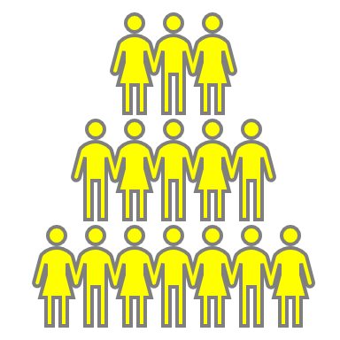
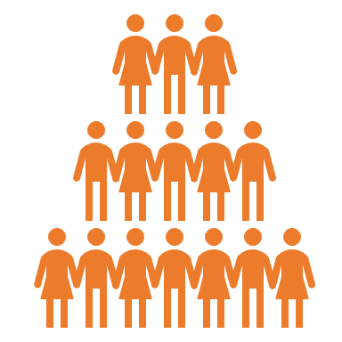
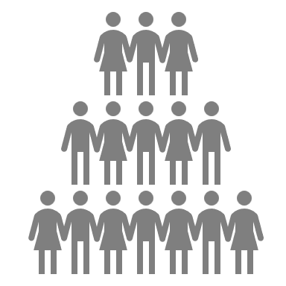
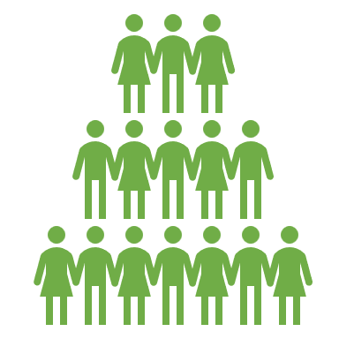
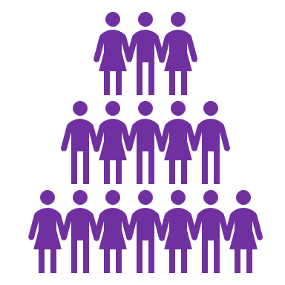
When diluted, we are all mostly “consumers”
Even with high effort capacity, the total amount of effort one can provide is still finite, and the more communities one belongs to, the higher the chances of dilution of efforts.
With the high variety of possible topics, the accessibility and the openness of potential members, the sum of all possible communities for a given person can be high. In such situation, there are low chances that one gets a very high engagement level in many communities.
In such case, we can assume that members of all communities begin by default with the best “direct value to effort” ratio, which can often be obtained with the “consumer” engagement level.
Therefore, there is no point in as morally judging low engagement level members in negative terms, especially in a context in which they are exposed in multiple community opportunities, and without knowledge of their base effort capacity.
The corollary to this proposition is that we should not feel morally wrong, as Community boosters, if our Community currently has a high proportion of consumers, especially if joining the Community is open to anyone.
Community B
Community A
Community C
Community E
Community D

Slide 42
When diluted, we are all mostly “consumers”
Community Boosters can on the other hand, explicitly choose their strategy to target a specific size and level of activity. You can use the Multiscale Community Matrix (MsCM) for this purpose.
As community booster, trying to do our best with everyone’s being in their “best effort mode” is the most scalable solution at organization level.
At organization level, even if all communities have the means to “increase engagement”, it can lead to a competition of value for members’ effort capacities. But as all communities can organize high engagement activities, it would be rare to meet the case in which all communities match their ambitions because members effort would move from one community to another depending on the value.
Also, high competition of Communities for members (or potential members) attention can lead to an overload of attraction signals, infobesity, stimuli fatigue which would increase the pressure for direct value and remove a part of the effort capacity even before joining any community.
Therefore, if an organization wants to promote communities, it must consider these phenomena and sometimes establish a global strategy that can sometimes include prioritization and rationalization unless there are much more capacity than communities to exploit it.
Community B
Engage more !
Engage more !
Engage more !
Community A
Community C
Engage more !
Engage more !
Community E
Community D

Slide 43
Increasing Community Activity level using relative engagement level model
The following section presents various recommendations and tips to increase the Community activity level for a given community. It is not of course an exhaustive list

Slide 44
Community tactics : Lowering the effort requirement for activities – General tips
General strategy
Using various methods of member inquiry, identify what type efforts are more painful or difficult for members
Prioritize on what actions you want to increase the activity
Prioritize structural changes that tackle the more difficult efforts
Reduce efforts of paying attention by reducing the number of channels and information points to follow, provide summaries and reminders
Reduce efforts of interaction by integrating someone to facilitate interaction, add rules of propriety
Reduce efforts of decision making by setting up habits, focusing the scope of decision to most important elements only and
Reduce efforts of learning by distributing new things to learn into levels, create and share tutorials for most frequent activities
Reduce efforts of context switching by focusing on activities for a longer period of time, ideally about topics that are currently related to members’ current life
Reduce efforts of scheduling by proposing a fixed time, several slots in which activities are repeated and of course integrating time constraints before planning
Reduce efforts of appreciating by promoting activities with people who really enjoy it
Reduce efforts to maintain psychological safety by setting up safety rules and train members on psychological safety behavior
Reduce effort accumulation by adding breaks within and between sessions, by considering the efforts that are already done by members and focusing on reduction of those, stop promoting culture of workaholism, distribute efforts among members.

Slide 45
Community tactics : Increasing the direct value of a given activity
Identify what are the members motivations, current short-term priorities and main pain points. Use polls, interviews, information from member representatives, potential members interviews, feedback sessions, …
Record members preferences and needs for example using Empathy Map or personas.
Prepare custom-made events based on Community needs and preferences or target content
Improve targeting of content and activities, using decision grids like Topics Mapping for topics, and user preferences, collective voting
Clarify and communicate about the short-term and long-term value of activities (assume by default that value is unclear) for members
Split indirect value moments (organizational questions, etc.) into small bits, that are distributed in several events with mainly direct value.
Separate direct value events from indirect value events. Open indirect value events for level E4 minimum (Open opportunists)
For mainly indirect value sessions, use food, beverage, entertainment and events improvement
Split events into smaller groups in which members are less diluted (being 1 among 5 has higher chances to serve a member specific needs to be 1 among 500) and adapt activity to each smaller group.
Integrate marketplace and prioritization dynamics within your events to select the best activity for the day
Set up levels to increase chances to fit members’ current levels (for example, separate content & activities for beginners from content & activities for experts)
Focus activities (events and content) on shorter terms topics
Focus your communication on the positive effects of the Community activities (Proofs of Community Value - PoCV), not on the structure or idea of a Community (unclear value)

Slide 46
Community tactics : Increasing the engagement level of members
To increase ability to provide efforts for indirect value :
Develop relatedness among members (ability of members to feel related to problems of each other)
Promote the potential greater effect of indirect value in comparison with direct value (for example, benefits of learning deeply in comparison of snacking content from time to time)
To increase ability to provide efforts when value is unclear :
Promote test-and-learn mindset for activities in which value is still unclear
Integrate more retrospectives and reflective moments (“what did we learn ? How was it useful to us ?...”) to look back on value after trying
To increase global level of effort capacity :
Negotiate with other stakeholders the right for members to participate to the Community
Negotiate with other stakeholders the timeslots to get the timeslots during which members are the less tired

Slide 47
Community tactics : Recentering your community activities on highly engaged members
All the actions that are proposed in the previous slides take time and energy. It is up to you to keep balance between
Focusing on engaging more members
More chances of reaching critical mass for mutualization and credibility
Globally more efforts, more potential frustration, more risks of failure for potentially the same level of final impact
Recentering your efforts on most engaged members
Less efforts, more ability to focus, more resilient and stable Community
Less chances of reaching critical mass for mutualization and credibility

Slide 48
Example of activities types corresponding to relative engagement levels
E1 | E2 | E3 | E4 | E5 | E6 | E7
Consumers | Low effort Opportunists | Opportunists | Open opportunists | Long-termists | Open long-termists | Selfless Booster
As low effort as possible, and only for direct value | Can provide a low effort only, only for direct value | Can provide up to high efforts only for direct value OR Only low efforts for both direct and indirect value. | Can provide up to high efforts mostly for direct value, and low effort only for indirect long-term value | Can provide high efforts both for direct value and indirect value, but no efforts when value is unclear | Can provide high efforts for both direct and indirect value, but low effort only when value for self is unclear | Can provide high efforts for the Community vision, without explicitly knowing direct or indirect value for self.
🔔Community content to consume
🗣️🙊Community events in which participants are expected to be mostly passive (talks, lectures, etc.)
🗪Participation to community online discussions and interactions
🚒Participation to community workshops with direct value (solving short-term problems, serving current objectives, marketplace like-events, etc.)
✍️Contribution to community deliverables
💡Participation to community workshops with indirect value (learning, future issues, helping each other, capitalization, etc.)
⚙️Community offline contribution and tasks (organization, etc.)

Slide 49
Using Relative Engagement level scale in a workshop – Simple version
🔔Community content to consume
🗣️🙊Community events in which participants are expected to be mostly passive (talks, lectures, etc.)
🗪Participation to community online discussions and interactions
🚒Participation to community workshops with direct value (solving short-term problems, serving current objectives, marketplace like-events, etc.)
✍️Contribution to community deliverables
💡Participation to community workshops with indirect value (learning, future issues, helping each other, capitalization, etc.)
Using the relative engagement scale as a Workshop, it is recommended to only use the activities as the board levels.
Participants may feel uncomfortable with the name of the levels (opportunists, etc.), especially when it comes to disclose one’s position.
Also, the detailed description may be unclear as it requires to understand some concepts (high effort, low effort, direct value, indirect value …).
It reduces the workshop to 5 levels in its simplest current version
⚙️Community offline contribution and tasks (organization, etc.)

Slide 50
Using Relative Engagement level scale in a workshop – Simple version
🔔Community content to consume
🗣️🙊Community events in which participants are expected to be mostly passive (talks, lectures, etc.)
🗪Participation to community online discussions and interactions
🚒Participation to community workshops with direct value (solving short-term problems, serving current objectives, marketplace like-events, etc.)
✍️Contribution to community deliverables
💡Participation to community workshops with indirect value (learning, future issues, helping each other, capitalization, etc.)
⚙️Community offline contribution and tasks (organization, etc.)
The further on the right you are in this graph, the more arrows (activities) you can cumulate.

Slide 51
Using Relative Engagement level scale in a workshop – advanced version
E1 | E2 | E3 | E4 | E5 | E6 | E7
Consumers | Low effort Opportunists | Opportunists | Open opportunists | Long-termists | Open long-termists | Selfless Booster
As low effort as possible, and only for direct value | Can provide a low effort only, only for direct value | Can provide up to high efforts only for direct value OR Only low efforts for both direct and indirect value. | Can provide up to high efforts mostly for direct value, and low effort only for indirect long-term value | Can provide high efforts both for direct value and indirect value, but no efforts when value is unclear | Can provide high efforts for both direct and indirect value, but low effort only when value for self is unclear | Can provide high efforts for the Community vision, without explicitly knowing direct or indirect value for self.

